Slide 1
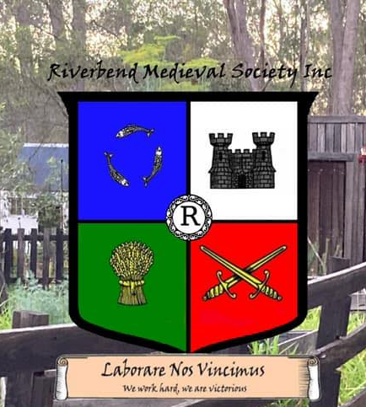
https://riverbend-medieval.org.au/

Slide 2
Riverbend Medieval Society Inc. is a vibrant community dedicated to bringing medieval history to life through authentic re-enactment. We offer a unique opportunity to step back in time and experience the rich culture, traditions, and crafts of the medieval period.
The society is comprised of three sub-groups:
Sevenoaks Early Medieval Company 850-950AD
The High Medieval Company 1100-1300AD
The Companie of the Badger 1350-1450AD
We are a group of people who are passionate about history and the Middle Ages. We are a group of people who are passionate about history and the Middle Ages. We are a group of people who are passionate about history and the Middle Ages.
https://riverbend-medieval.org.au/

Slide 3
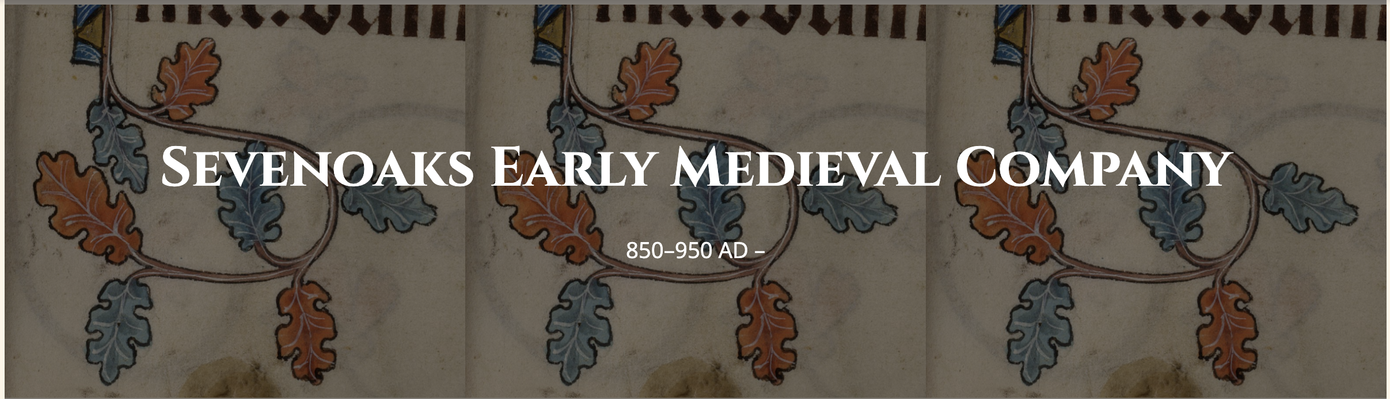
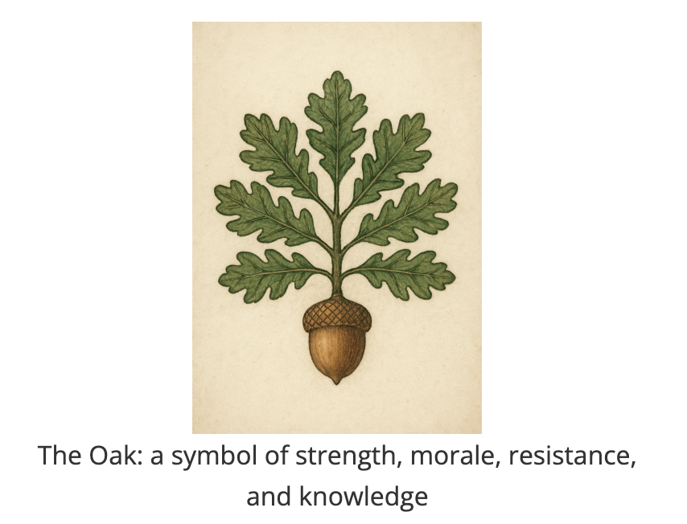
About Sevenoaks Early Medieval Company
Sevenoaks Early Medieval Company is a group dedicated to exploring and re-enacting the vibrant history of Europe between 850 and 950 AD, focusing on strong cultural mix of the period. Our name reflects both the seven cultures represented in our group and the oak as a symbol of strength, morale, resistance, and knowledge.
Anglo-Saxon
Danish
Irish/Celtic
Norwegian
Rus-Viking
Byzantine
Gotland
We celebrate the diversity and interaction of these cultures in early medieval Northumbria, bringing their stories to life through research, craft, and living history.
What We Do
Historical re-enactment of early medieval life
Demonstrations of period crafts and skills
Participation in medieval markets and events
Educational displays and workshops
Join Our Group
Whether you're interested in combat, crafts, or historical research, we welcome new members who share our passion for the early medieval period. No experience is necessary - we provide training and guidance for all aspects of medieval re-enactment.
https://riverbend-medieval.org.au/early-medieval.html

Slide 4

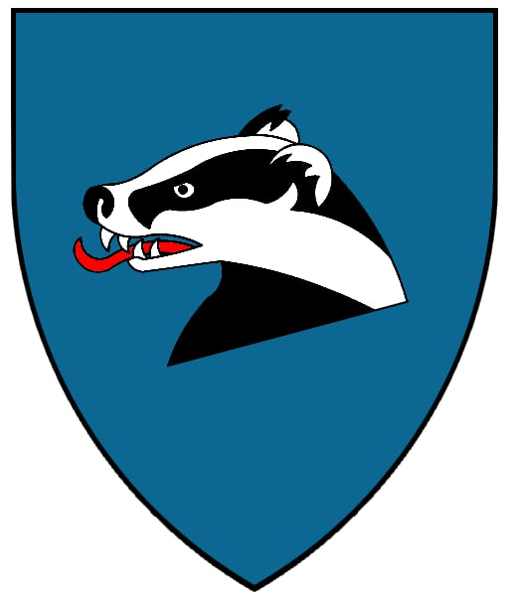
The Companie of the Badger represents the period from 1350-1450AD, a time of great change and innovation in medieval England. We aim to recreate this time period in our costume, camp, trades and arts, bringing to life the rich cultural heritage of late medieval England.
Our members engage in various activities including combat reenactment, historical crafts, music, and living history displays, all while maintaining historical accuracy in our portrayal of this fascinating era.
What We Do
Historical re-enactment of late medieval life
Demonstrations of period crafts and skills
Participation in medieval markets and events
Educational displays and workshops
https://riverbend-medieval.org.au/late-medieval.html

Slide 5
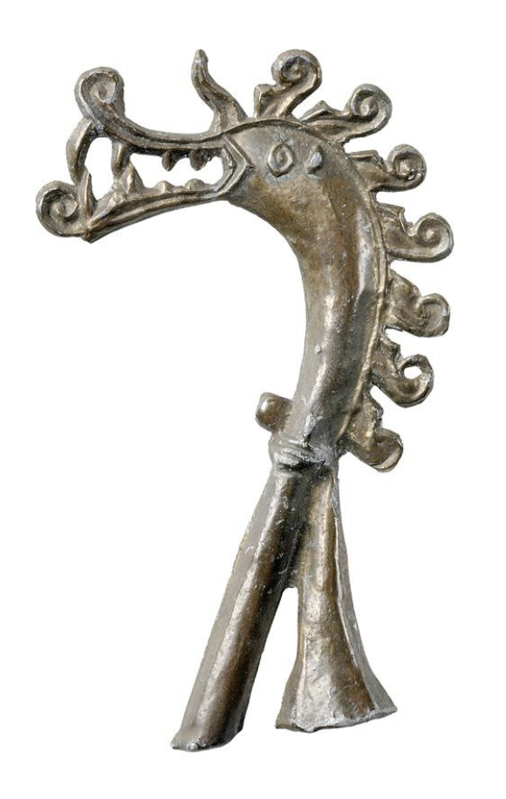

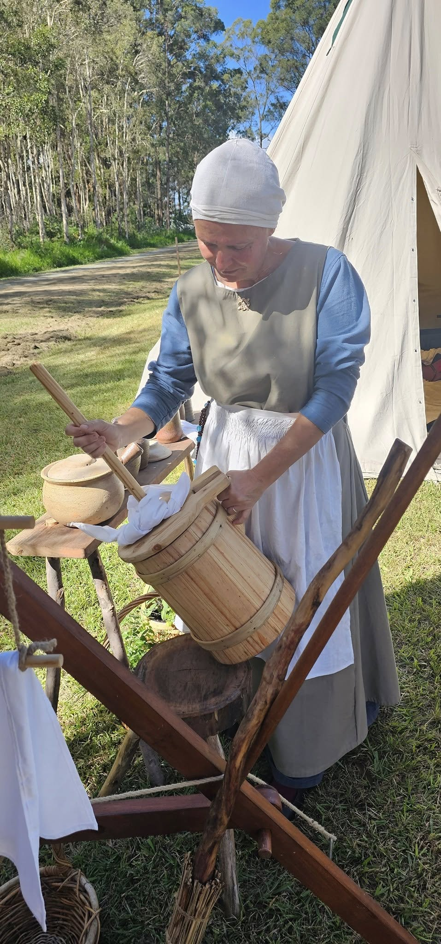
Dagmar Davidsdottir
Period: 9th Century
Origin: Birka, Sweden
Current Status: Craftswoman, Wife of Traeloch the Dark
Skills: Weaving, Sewing, Cooking, Animal Husbandry
Dagmar Davidsdottir is a skilled craftswoman whose life is deeply rooted in the traditions of 9th century Birka, Sweden. As a daughter of David, she carries the patronymic name that reflects her heritage and family lineage. Her expertise in traditional crafts makes her an invaluable member of the Riverbend Medieval Society, where she brings the authentic practices of Viking-era Scandinavia to life.
Her primary skills include weaving, sewing clothing, cooking, and tending to animals - all essential aspects of daily life in Viking-age Scandinavia. These skills were passed down through generations of women in her family, and she takes great pride in maintaining these traditions with historical accuracy.
One of Dagmar's current passions is the creation of authentic Viking-era tents and camping equipment. This project is particularly important as it will enable the Riverbend Medieval Society to participate in Viking-inspired reenactment events with historically accurate gear. Her knowledge of traditional materials and techniques ensures that these items are not only functional but also true to the period they represent.

Slide 6
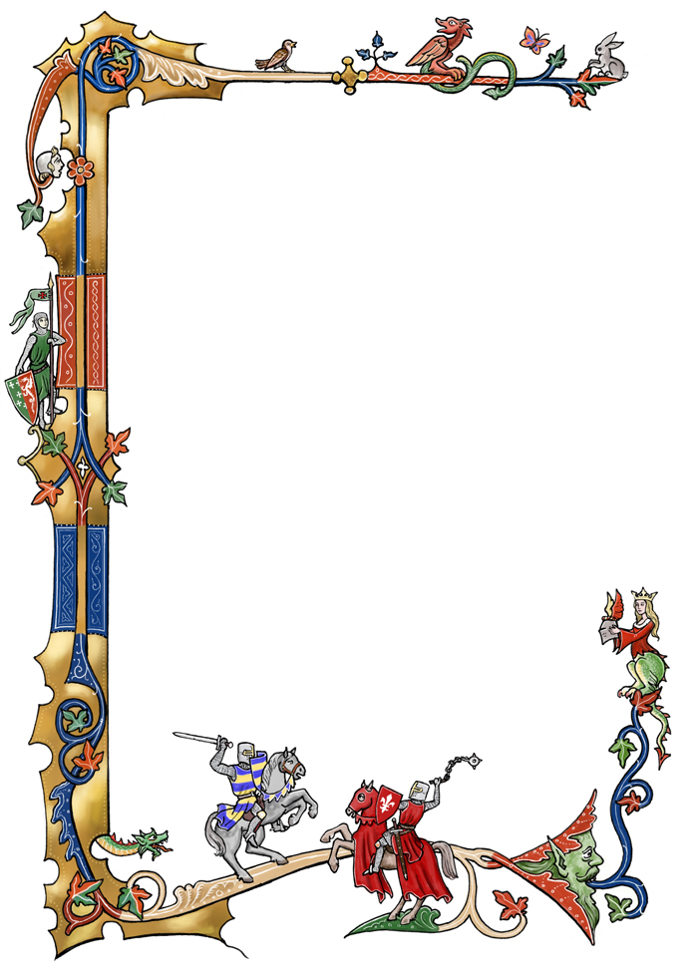
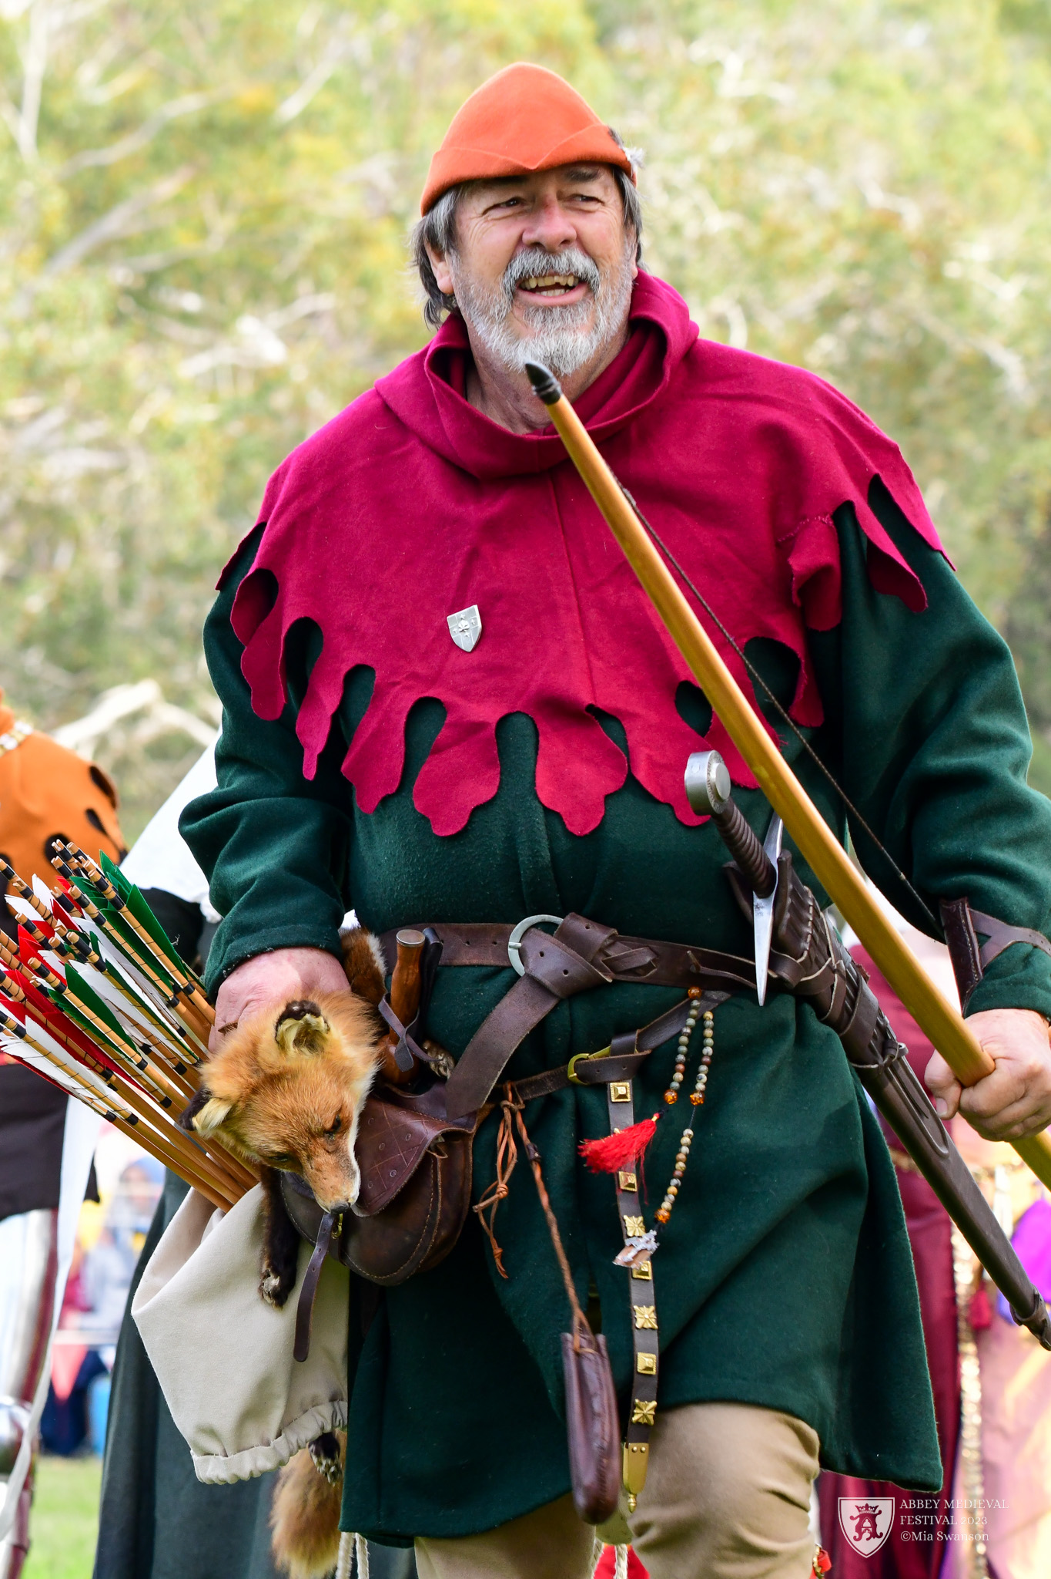
Yeoman Roger Greenewood
Birth: 19th November 1330, Hundred of Macclesfield, Cheshire, England
Current Age: 54 years (as of 1384)
Occupation: Yeoman Archer, Ventenar
Current Affiliation: Companie of the Badger
Previous Affiliations: Army of Edward III, Free Companies, White Company of John Hawkwood
Notable Skills: Archery, Military leadership, Campaign strategy
Background: Son of a Husbandman farmer with 80 acres near Macclesfield Forest

Slide 7
Born on the 19th of November, 1330, in the Hundred of Macclesfield, Cheshire, Roger Grenewood's life began in the shadow of the Macclesfield Forest, near the flowing waters of the River Goyt. As the son of a Husbandman farmer who tended to a notable 80 acres of land—a holding suggesting a family of some substance within their class—young Roger learned the value of hard work and precision from an early age. His natural talent with the longbow, a skill honed through compulsory practice for English yeomen, soon became apparent. When the call to arms came from King Edward III for his campaigns in France, Roger, then a youth of fifteen, answered without hesitation. His skill with the bow would serve him well, particularly at the momentous Battle of Crécy on the 26th of August, 1346, where he fought as an archer in the victorious English ranks. In the aftermath of Crécy, as English forces moved through Normandy, Roger Grenewood found himself in the city of Rouen. Meanwhile, the widowed Lady Cristine, stranded and seeking to arrange passage back to England, had also sought shelter with friends in the same city.
It was in Rouen, a city that would soon face the horrors of the Black Death, that their paths converged. Roger, the yeoman archer, and Cristine, the grieving noble widow, met. Their shared experience of the recent battle and its profound impact, coupled with Cristine's vulnerable position and Roger's protective presence, forged an unlikely bond. Despite the considerable social differences, their connection deepened. In October 1348, with Rouen in the grip of the Black Death which peaked that spring and summer, they were married at the ancient abbey of Saint-Ouen. For Cristine, a widow with greater autonomy over her choices, and in a world disrupted by war and pestilence, this union with a capable soldier offered a measure of security and companionship. The years that followed saw Cristine adapt to a life starkly different from her noble upbringing. She traveled with Roger as he sought service with the Free Companies—mercenary bands that roamed France, particularly active in Normandy, Gascony, and Aquitaine during lulls in the main conflict. Cristine learned to navigate the challenges of life on campaign, a common, albeit arduous, experience for soldiers' families.
When Edward III renewed the war with France in 1355, Roger rejoined the royal forces. His skill and leadership during the Black Prince's devastating grande chevauchée of 1355 earned him a promotion to the rank of Ventenar, an officer typically in command of about twenty men. While Roger fought in this campaign and subsequently at the decisive English victory at the Battle of Poitiers in 1356 alongside Edward of Woodstock (the Black Prince), Cristine often remained in relatively safer areas within English-held territories like Aquitaine, Normandy, or Brittany.

Slide 8
During these tumultuous years, Cristine and Roger were blessed with three sons. Raised amidst the realities of military life, all three would eventually follow in their father's footsteps, becoming men-at-arms in service to the English crown. Despite the constant upheaval and dangers, Cristine maintained her noble bearing, providing a stable presence for her family.
Roger's military career continued its relentless pace. He later joined the legendary White Company, commanded by Sir John Hawkwood, fighting throughout the Italian peninsula until approximately 1367. His service saw him at the Battle of Nájera in Castile in 1367, fighting under the Black Prince, and at the infamous Siege of Limoges in 1370, where the Black Prince's army, including its archers, took the city.
After the death of Edward of Woodstock in 1376, Roger and Cristine, ever adaptable, returned to service with Free Companies, continuing their martial existence throughout France and Gascony. Finally, in 1380, after decades of warfare, Roger, now fifty, and Lady Cristine returned to England. There, Roger's experience found a new outlet. He joined the Companie of the Badger, a Free Company, as their Ventenar. In this role, he continued to lead archers, bringing his wealth of battlefield experience and leadership to train and command men, sometimes for campaigns on the continent.
Lady Cristine, ever his steadfast partner, continued to support her husband in his endeavors with the Companie of the Badger. Her heraldry, a poignant combination of the Davenport arms (Argent a chevron between 3 crosses crosslet fitchee Sable) and her first husband's De Clare arms (Or three chevrons Gules), served as a constant visual reminder of her noble lineage and the extraordinary, challenging, and ultimately intertwined chapters of her life alongside the yeoman archer who became her husband.
The lives of Roger Grenewood and Lady Cristine, from the fields of Macclesfield and the halls of Essex nobility to the blood-soaked battlefields of France, Italy, and Spain, weave a remarkable tapestry through the heart of the Hundred Years' War. Their story is a testament to endurance, adaptation, and the unexpected bonds forged in the crucible of medieval conflict.

Slide 9
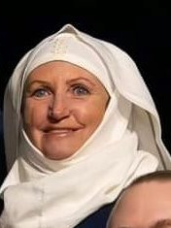
Lady Cristine Greenewood
Full Name: Lady Cristine Grenewood (née Davenport, formerly de Clare)
Birth: 26th March 1330, Sible Hedingham, Essex
Current Age: 54 years (as of 1384)
Current Status: Wife of Roger Grenewood, Ventenar of the Companie of the Badger
Family Background: Daughter of Sir Robert Davenport, knight in service to John de Vere, 7th Earl of Oxford
Previous Marriage: Widowed from Sir Hugh de Clare (killed at Crécy, 26th August 1346)
Children: Three sons, all serving as men-at-arms for the English Crown

Slide 10
Lady Cristine's journey began far from the fields of Cheshire. Born on the 26th of March, 1330, in the Essex village of Sible Hedingham, her early life unfolded within the noble household of the Earl of Oxford. She was the daughter of Sir Robert Davenport, a knight in service to John de Vere, the 7th Earl of Oxford, and was raised with the values and expectations of the English nobility. In 1344, at the tender age of fourteen, Cristine was married to Sir Hugh de Clare, a minor knight also in the Earl of Oxford's service.
Their life together was tragically brief. Accompanying Edward III's expedition to France, Sir Hugh de Clare fought and fell at the Battle of Crécy on the 26th of August, 1346, the same battle where Roger Grenewood served. This devastating loss left Cristine, barely sixteen, a widow in a war-torn foreign land.
In the aftermath of Crécy, as English forces moved through Normandy, Roger Grenewood found himself in the city of Rouen. Meanwhile, the widowed Lady Cristine, stranded and seeking to arrange passage back to England, had also sought shelter with friends in the same city. It was in Rouen, a city that would soon face the horrors of the Black Death, that their paths converged. Roger, the yeoman archer, and Cristine, the grieving noble widow, met. Their shared experience of the recent battle and its profound impact, coupled with Cristine's vulnerable position and Roger's protective presence, forged an unlikely bond. Despite the considerable social differences, their connection deepened. In October 1348, with Rouen in the grip of the Black Death which peaked that spring and summer, they were married at the ancient abbey of Saint-Ouen. For Cristine, a widow with greater autonomy over her choices, and in a world disrupted by war and pestilence, this union with a capable soldier offered a measure of security and companionship.
The years that followed saw Cristine adapt to a life starkly different from her noble upbringing. She traveled with Roger as he sought service with the Free Companies—mercenary bands that roamed France, particularly active in Normandy, Gascony, and Aquitaine during lulls in the main conflict. Cristine learned to navigate the challenges of life on campaign, a common, albeit arduous, experience for soldiers' families.
When Edward III renewed the war with France in 1355, Roger rejoined the royal forces. His skill and leadership during the Black Prince's devastating grande chevauchée of 1355 earned him a promotion to the rank of Ventenar, an officer typically in command of about twenty men. While Roger fought in this campaign and subsequently at the decisive English victory at the Battle of Poitiers in 1356 alongside Edward of Woodstock (the Black Prince), Cristine often remained in relatively safer areas within English-held territories like Aquitaine, Normandy, or Brittany.

Slide 11

During these tumultuous years, Cristine and Roger were blessed with three sons. Raised amidst the realities of military life, all three would eventually follow in their father's footsteps, becoming men-at-arms in service to the English crown. Despite the constant upheaval and dangers, Cristine maintained her noble bearing, providing a stable presence for her family.
After the death of Edward of Woodstock in 1376, Roger and Cristine, ever adaptable, returned to service with Free Companies, continuing their martial existence throughout France and Gascony. Finally, in 1380, after decades of warfare, Roger, now fifty, and Lady Cristine returned to England. There, Roger's experience found a new outlet. He joined the Companie of the Badger, a Free Company, as their Ventenar. In this role, he continued to lead archers, bringing his wealth of battlefield experience and leadership to train and command men, sometimes for campaigns on the continent.
Lady Cristine, ever his steadfast partner, continued to support her husband in his endeavors with the Companie of the Badger. Her heraldry, a poignant combination of the Davenport arms (Argent a chevron between 3 crosses crosslet fitchee Sable) and her first husband's De Clare arms (Or three chevrons Gules), served as a constant visual reminder of her noble lineage and the extraordinary, challenging, and ultimately intertwined chapters of her life alongside the yeoman archer who became her husband.
The lives of Roger Grenewood and Lady Cristine, from the fields of Macclesfield and the halls of Essex nobility to the blood-soaked battlefields of France, Italy, and Spain, weave a remarkable tapestry through the heart of the Hundred Years' War. Their story is a testament to endurance, adaptation, and the unexpected bonds forged in the crucible of medieval conflict.
Lady Cristine's Personal Heraldry
A combination of the Davenport and De Clare arms, symbolizing her noble lineage and life's journey

Slide 12
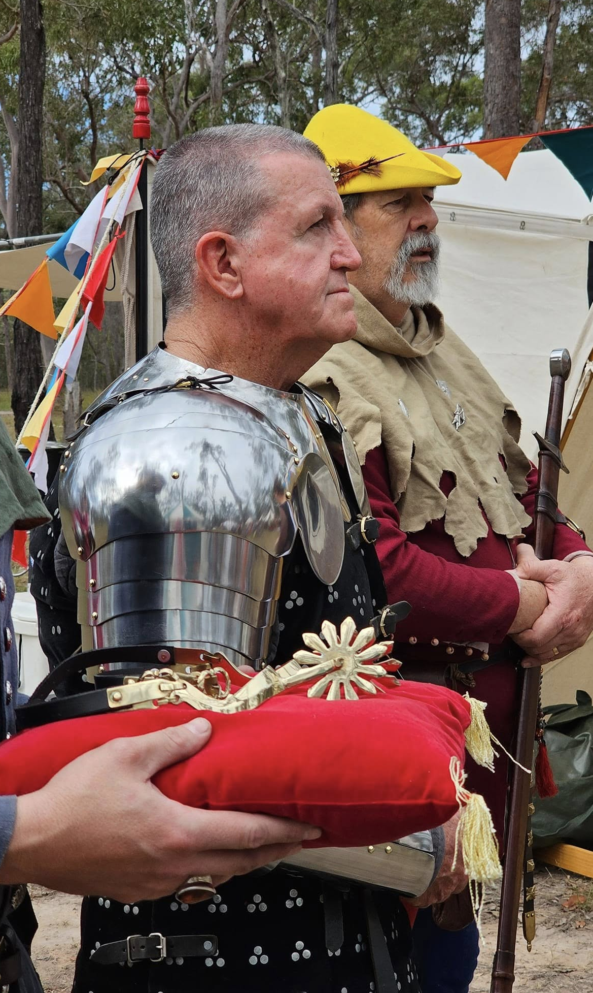
Sir Godwin Black
Full Name: Sir Godwin Black
Birth Year: 1366
Birthplace: Llantilio Grossenny, near White Castle
Current Year (Persona): 1416
Current Age: 50
Social Standing: Knight Bachelor
Early Life & Youth (c. 1366 - 1386)
Born in the village of Llantilio Grossenny near White Castle, Godwin grew up in a family of carpenters. While he learned the family trade in his father's workshop, his true passion lay in the martial arts. He spent countless hours observing the Men-at-Arms stationed at White Castle, studying their techniques and practicing what he had seen.
Service with Hotspur (1386 - 1388)
In April 1386, seeking to test his skills in real combat, Godwin joined the army of Sir Henry (Hotspur) Percy. The campaign took them to Calais, where they conducted numerous raids into the Picardy region of France. This experience proved invaluable, teaching Godwin the realities of warfare and the importance of discipline and leadership.

Slide 13
White Castle Service & Family Life (1388 - 1402)
Following the campaign, Godwin returned to White Castle and secured a position as a Man-at-Arms. In 1390, he married Edith Annabelle, a young maiden from the local village. Together they built a life in the village, raising two daughters while Godwin continued to serve at the castle. This period allowed him to balance his martial duties with family life, developing both his combat skills and his understanding of leadership.
Battle of Homildon Hill (1402)
In 1402, Godwin once again answered the call to arms, rejoining Sir Henry Percy's forces for the campaign against the Scots. At the Battle of Homildon Hill, he distinguished himself by playing a crucial role in the capture of Archibald Douglas, 4th Earl of Douglas, the commander of the Scottish army. His actions during the battle earned him lands near White Castle, marking his rise in status and recognition of his martial prowess.
The Agincourt Campaign (1415)
Godwin's military career reached its zenith when he joined King Henry V's army for the campaign in France. At the Battle of Agincourt on October 25th, 1415, he witnessed the devastating effectiveness of the English longbow as 7,000 archers supported 1,500 men-at-arms against a French host of 10,000 men-at-arms. The battle resulted in a decisive English victory, and Godwin's contributions to the campaign were recognized with his elevation to the order of Chivalry as a Knight Bachelor.
Later Life (1415 - Present)
After Agincourt, Sir Godwin returned to White Castle and resumed his life with Edith. Now a Knight Bachelor, he maintains his martial skills while living a more peaceful life. He and Edith travel the lands attending tournaments, where he can demonstrate his prowess and honor while enjoying the pleasures of chivalric competition. His experience and status make him a respected figure in the local community, and he continues to serve as an example of the ideal medieval knight.

Slide 14
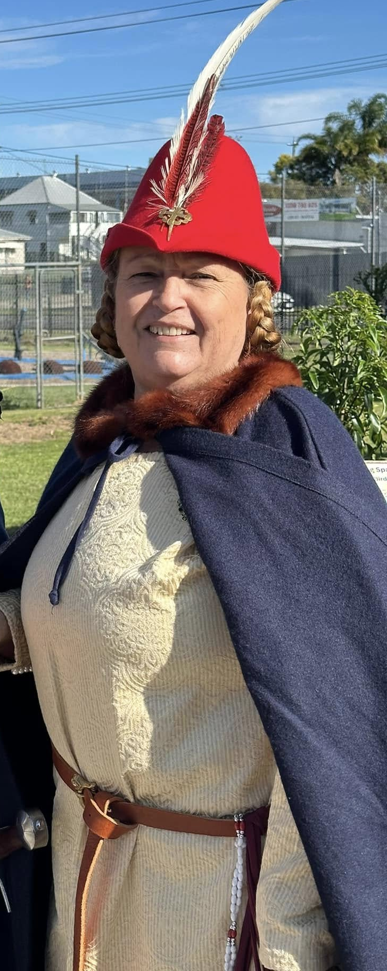
Lady Edith Black
Full Name: Lady Edith Black (née Moore)
Birth Year: 1371
Birthplace: Wicklow, Ireland
Current Year (Persona): 1416
Current Age: 45
Social Standing: Lady (Wife of a Knight Bachelor)
Early Life in Ireland (1371 - 1377)
Born in Wicklow, Ireland to an English father, George Moore from Hereford, and an Irish mother, Aisling Byrne, the daughter of a merchant. Her early years were happy until tragedy struck when she was six years old. Her mother died during childbirth, and the baby did not survive either. This loss deeply affected her father, who struggled to care for a young child in his grief.
Life with Aunt Katherine (1377 - 1381)
In the wake of her mother's death, Edith's father's widowed sister, Katherine, came to live with them. Katherine took on the role of raising Edith, providing her with a proper education. Under Katherine's guidance, Edith learned fundamental reading and writing, developed skills in sewing, and received instruction in music. These four years with her aunt provided stability and education, but sadly ended when Katherine fell ill and passed away.

Slide 15
Education at the Convent (1381 - 1390)
After Katherine's death, Edith's father arranged for her to be educated at a convent on the English/Welsh border. This period proved to be a formative time in her life. The convent provided her with advanced education in reading, writing, and mathematics. She developed a particular interest in gardening and medicinal herbs, learning extensively from one of the sisters. The convent's location allowed her to develop a deep appreciation for the English countryside and its people.
The sisters, while strict, were kind and included the girls in their weekly outings to local markets. These trips served multiple purposes: selling medicinal herbs, ministering to the local community, and providing practical experience in commerce and healing. It was during one of these market visits that Edith first met Godwin Black, who was selling wood products. Their friendship grew, and she eagerly anticipated the market days when she could see him.
Marriage and Family Life (1390 - 1415)
In 1390, Edith married Godwin Black, who was then serving as a Man-at-Arms at White Castle. They established their home near the castle, where they raised their daughters. While Godwin was frequently called away to serve the King in various campaigns, Edith capably managed their holding and family. Her education in both practical and domestic skills served her well in running their household and raising their children.
Life as Lady Black (1415 - Present)
After Godwin's return from the Battle of Agincourt in 1415, where he was raised to the rank of Knight Bachelor, Edith became Lady Edith Black. This elevation in status brought new responsibilities and opportunities. Together with Godwin, they now travel throughout the land, attending tournaments and fairs. Her early education in music and her experience in managing a household continue to serve her well in her role as a knight's wife. Her knowledge of medicinal herbs and healing practices also makes her a valuable member of their community, as she can provide care and assistance when needed during their travels.

Slide 16
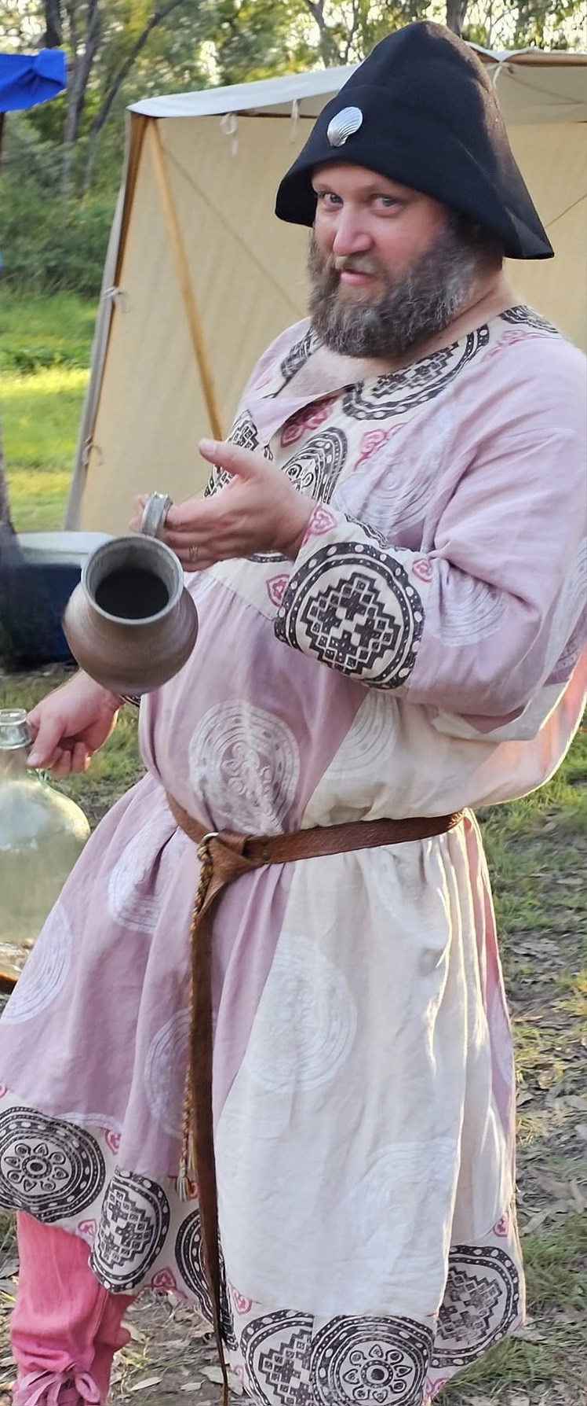
Stephanus Attebregge
Full Name: Stephanus Attebregge (or 'Stephen')
Birth Year: 1372
Birthplace: Bermondsey, Surrey (South London)
Current Year (Persona): 1416
Current Age: 44
Social Standing: Commoner, Veteran Man-at-Arms
Childhood & Youth (c. 1372 - 1390)
Born and raised in Bermondsey into a family of fish smokers. They processed fish brought in via the Thames, preparing it for sale or preservation. They traded their goods at nearby Borough Market or across the river at the larger Billingsgate Fish Market. The byname 'Attebregge' suggests his family's historic and current proximity to London Bridge.
Grew up accustomed to the physical labour and distinct smells of the fish trade, as well as the bustling, sometimes rough, environment near the southern end of London Bridge. Received minimal formal education; learned practical skills and the ways of the working class near the capital.
Leaving Home & City Watch (c. 1390 - 1394)
Seeking opportunity or a different path, Stephanus left his family. He found service in the London City Watch for a few years, specifically serving his duty within Bridge Ward Within. This provided discipline, basic arms training (with a bill and staff), and experience navigating the complexities of the city under the authority of the Aldermen, Sheriffs, and ultimately the Lord Mayor.

Slide 17
Early Military Career (c. 1394 - 1414)
In 1394, widespread recruitment began for King Richard II's large expeditionary force to Ireland. Stephanus joined the army, signing on with the large retinue of Roger Mortimer, Earl of March, the King's Lieutenant in Ireland. His initial role was as a billman. He gained his first taste of formal military campaigning during the 1394-95 Irish expedition under Mortimer.
Following his return, from roughly 1396 to early 1399, he found service in the Calais Garrison, serving under an experienced knight, Sir Thomas Rempston. In 1399, he was recalled from Calais to join Richard II's second expedition to Ireland, this time serving in the retinue of John Montacute, Earl of Salisbury, a loyal supporter of the King. This meant he was out of the country during Henry Bolingbroke's usurpation.
Upon returning to England in late 1399 or early 1400, Stephanus found Henry IV on the throne and that his recent captain, the Earl of Salisbury, had been captured and executed for remaining loyal to Richard II. This left Stephanus abruptly unemployed and needing to demonstrate his willingness to serve the new Lancastrian regime.
Fortunately, Owain Glyndŵr's rebellion ignited in Wales in 1400, creating an immediate demand for experienced soldiers. Stephanus quickly found new service in forces heading to the Welsh Marches. He spent significant time over the next decade campaigning there, particularly around Monmouthshire, serving in forces associated with Prince Henry's campaigns, and under the direct command of local loyalist captains like Sir William ap Thomas operating within the Prince's command structure. He participated in garrison duty, patrols, actions aimed at relieving besieged castles (like Usk or Grosmont), and was part of the forces involved in the Battle of Pwll Melyn in 1405.
Through this continued service under Henry IV and then Henry V, he progressed fully to the status of a Man-at-Arms, acquiring better armour and proficiency with sword and dagger alongside his polearm skills. Functioned as a reliable retainer or hired soldier, not a traditional young squire.
The Agincourt Campaign (1415)
As a veteran Man-at-Arms, he joined King Henry V's army for the campaign in France, serving in the substantial retinue of Edward, Duke of York. Endured the Siege of Harfleur and the subsequent arduous march.
At the Battle of Agincourt (October 25th): Fought dismounted in the main battle (centre division) under the command of the Duke of York (who died in the fighting). Stood shoulder-to-shoulder with knights and other men-at-arms, facing French charges. Witnessed the devastating effect of English archery and participated in the brutal melee. Survived through skill, endurance, and perhaps the fortune of battle.

Slide 18
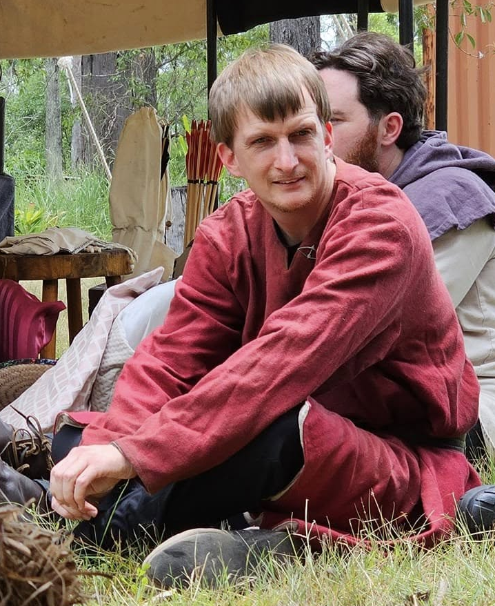
Sergeant Douglas
Full Name: Sergeant Douglas
Birth: 1330, York, England
Current Age: 34 years (as of 1364)
Occupation: Military Sergeant, Combat Trainer
Current Affiliation: Under the banner of Sir Michael
Previous Affiliations: Duke of Gascony's forces
Notable Skills: Combat training, Military tactics, Interrogation, Trade route protection
Background: Common-born, third child of a Scandinavian ministerial and a shrewd mother

Slide 19
Born in the bustling city of York in the year of our Lord 1330, Douglas's origins were modest. His father, a man of moderate talent, was an agent or administrator, possibly connected to Scandinavian or Hanseatic trading interests for which York served as a depot. His mother, however, possessed a sharp wit and a keen understanding of trade and other practical skills, which she diligently sought to impart to her children. This commercial awareness in the family would subtly shape Douglas's path.
As the third child, Douglas inherited little in the way of land or fortune, a common fate for younger sons not destined for the Church. His early prospects seemed bleak. Despite attempts to secure work as an entertainer, his distinct lack of musical skill meant he often struggled for a meager meal or two.
Luckily for Douglas, a great war was brewing.
From around the age of fifteen, in 1345, as tensions from the Hundred Years' War continued to escalate across the Channel, Douglas found himself drawn into the burgeoning conflicts. He began to acquire basic martial skills, and his natural, if rough-hewn, charisma proved surprisingly effective. Leveraging his family's potential trade connections, he found early work protecting vulnerable trade routes, a vital necessity in an era of banditry and lawlessness. For the next several years, he honed his martial prowess, not in the tourney grounds of chivalry, but in the brutal crucible of necessity. He also acquired a dark practical education, learning how to "persuade" a man who stole valuable goods, how to assess the worth of a human life for ransom, and how much a human life was worth when extinguished—skills common in the irregular warfare and mercenary activities of the time.
By 1349, with the Black Death ravaging England and causing immense social upheaval, Douglas, now nineteen, made his way from a plague-stricken London, crossing the narrow sea to Normandy. English forces maintained a presence in parts of Normandy, and amidst the chaos of ongoing conflict and the plague's aftermath, he found a new purpose. His burgeoning experience allowed him to help rally and train local militias, turning peasants into serviceable, if raw, fighting men to bolster depleted local defenses.
You might find Sergeant Douglas still patrolling the dusty streets of a frontier town in English-held France, or perhaps in the sprawling camp of an expeditionary force. He will gladly show you the way of the sword, if you dare to ask him. Or he may just as easily place you in chains for a minor transgression. With Sergeant Douglas, who knows what will happen? His path is as unpredictable as the war that shaped him.

Slide 20
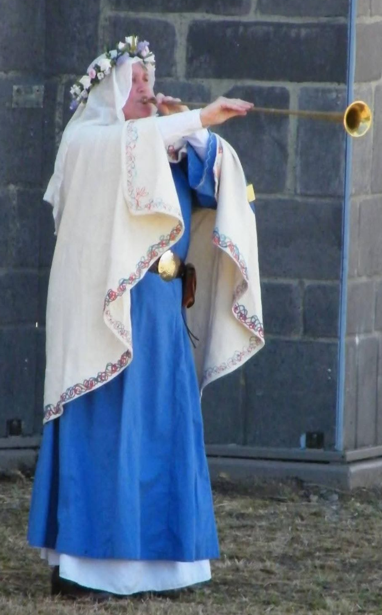
Merchant Lady Sue
Full Name: Merchant Lady Sue
Birth: 1060, Southern England
Current Age: 24 years (as of 1084)
Current Status: Merchant, Wife of The Woodsman
Family Background: Daughter of a Chamberlain in a noble household
Marriage: Married to The Woodsman (1110)
Born in 1060 into a small court in southern England, Merchant Lady Sue's life began in privileged circumstances. As the daughter of the Chamberlain, she was raised alongside the Lord's children, receiving an education that was rare for women of her time. This early exposure to court life and learning would shape her future in ways she could not have imagined.
Growing up in the aftermath of the Norman Conquest, Sue witnessed firsthand the transition from Saxon to Norman customs. While she adapted to the new Norman manners expected at court, she maintained a fondness for the more relaxed Saxon lifestyle of her early years. This unique perspective would later serve her well in her merchant life, allowing her to navigate between different cultural contexts.

Slide 21
In 1110, her life took a dramatic turn when she met The Woodsman while traveling north with her father on business. The Woodsman, who had been journeying across the land in search of his family while trading goods, captured her heart. Their marriage marked the beginning of a new chapter in her life.
Together, they became known as "The Merchants of No Manors," traveling extensively throughout the land without a permanent home. This nomadic lifestyle, while challenging, allowed them to build a network of contacts and gain valuable experience in trade. Their reputation as fair and honest merchants grew, and they became known for their ability to bridge cultural divides.
Their wandering days came to an end when they discovered Victory Village at Riverbend. Here, they found not just a place to settle, but a community that welcomed them with open arms. The village's location and atmosphere provided the perfect setting for their merchant activities, and they have since established themselves as valued members of the community.
Today, Merchant Lady Sue continues to ply her trade, using her education and court experience to navigate the complex world of medieval commerce. Her ability to move between different social circles and cultural contexts makes her an invaluable member of the Riverbend community, while her merchant activities help to connect the village with the wider world.

